Slide 1
Module 6: Remote API Protocol
SER 423

Slide 2
API Refresh

Slide 3
What is an API?
An API if you’re not quite sure is a public interface of functions and methods that another function or method can call
Whenever you define a public method in a class, this is technically an API
What we really mean with API though is that you have defined some sort of interface that your code implements
  This technically does not have to be an actual interface, but often is
The functions or methods in this interface are publically accessible
In short, you are providing some sort of functionality for other classes and functions to use

Slide 4
How Do We Use an API?
When we need to use an API we first need to import the library into our file
Each API should provide specification on how to use it
This usually takes the form of either building an object and calling methods on it
  Or making references to static methods without an object reference
You have used APIs consistently by now
Examples from Java include: System.out.println, Math.max, and the Random library
These all provide functionality you can use in your program without having to write it yourself
When you write a class and another class uses it, that is again an overly simplified example of an API
Usually, we make API calls on the same system, and within the same program

Slide 5
Remote API Calls

Slide 6
What Then Are Remote API Calls?
A remote API call is calling an API that exists on another device over a network
You essentially make a request, provide the needed information, and wait for a response
This is asking another computer to do work for you
This might sound odd, but it is actually extremely common
Thanks to the internet
  This is pretty much how it works
Most backend processes are triggered by these types of calls
Servers do some sort of calculation, or fetch some sort of data, and send the result or data back to the client

Slide 7
Looking at HTTP
The Hypertext Transfer Protocol is one of the most common means of communication between clients and servers
The client will build a request of a given type and the server will respond
There are several types of HTTP requests:
  GET
  POST
  PUT
  HEAD
  DELETE
  PATCH
  OPTIONS
  CONNECT
  TRACE
GET and POST are by far the most common and we will focus on those two

Slide 8
GET Requests
Use a GET request to ask for data
  These cannot modify data
Usually, you will need to provide some sort of query with your request
  Basically, you need to define what you are asking for
There should be a parameter and a value
  The parameter is provided by the API and represents the name of the variable being set
    Examples would be: name, courseNumber, minValue, etc.
  The value is what within that parameter you are asking for
    Examples matching the above would be: Baron, 423, 70, etc.
These values are appended to the end of the URL after a ? and are separated by &’s
You have likely seen these in URLs before
  someSite.com/pageName.php?name1=value1&name2=value2

Slide 9
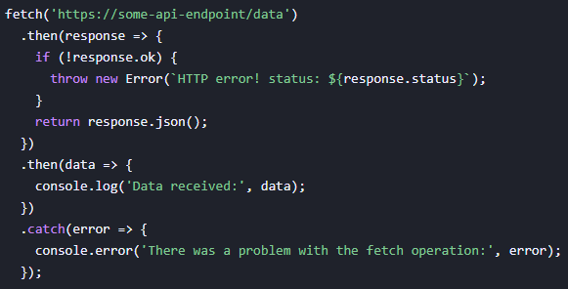
GET Example

Slide 10
POST Requests
While GET was only to fetch data, POST is used to change it
You make a POST request to update an existing value, or create it if it doesn’t exist already
This is formatted in a similar way to GET requests
  That is to say that you list the parameter and the new/updated value like you do with a GET request
Examples of making a POST requests are: liking a YouTube video, posting a comment on an assignment in Canvas, etc.
As is likely obvious, any good server admin will lock down what POST requests are accepted

Slide 11
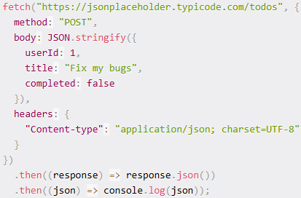
POST Example

Slide 12
End of Remote API Protocol
Next time - Making Remote API Calls

